Slide 1
A “quantum-secure” scheme :
QKD + OTP
Practicum by Abhro Bhuniya
MS in Cybersecurity - Information Security Track

Slide 2
TOC
Introduction
Motivation
What has been done ?
What are security definitions ?
Goals
Can we do it classically?
QT + OTP
Analysis
Conclusion

Slide 3
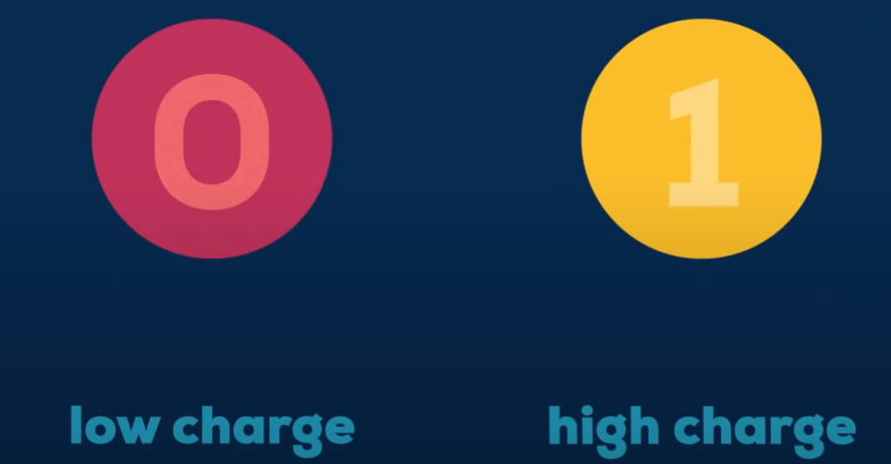



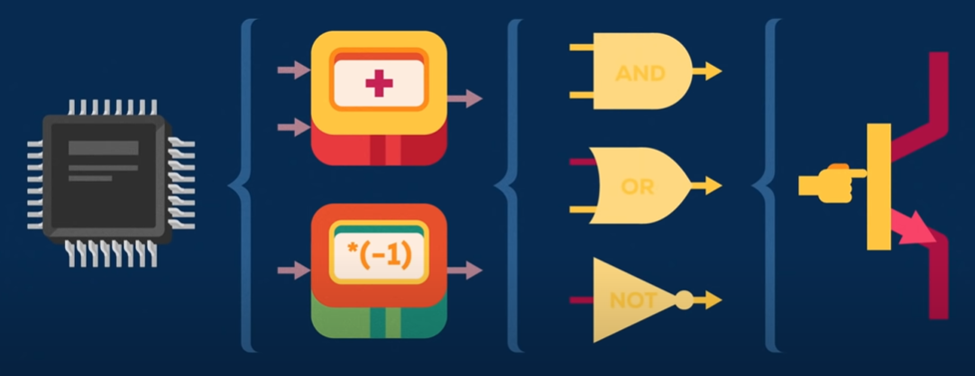
What is a quantum computer?
circuit chip modules logic gates transistors
Quantum Superposition

Slide 4
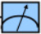
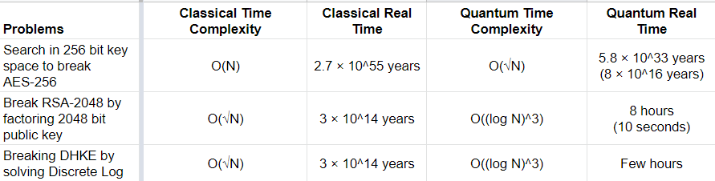
The quantum power
|x_{i}〉 + |x_{j}〉 + |x_{k}〉 + …
Find x₀, s.t. f(x₀) = w ⇨
|1〉 + |2〉 + |3〉 + …
F_{w}
X₀
|x〉
Notes:
a QC with n qubits can try 2n combinations simultaneously.
world’s fastest supercomputer, Sunway TaihuLight
Bristlecone, which has 72 qubits, can try 272 (4, 722, 366, 482, 86,9 645, 213, 696) values.

Slide 5
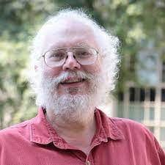
The quantum power
For many years it has been known that both the integer factorization problem, upon which RSA is based, and the elliptic curve discrete logarithm problem (ECDLP), upon which ECC is based, can be solved in polynomial time by a quantum computer.
Shor’s algorithm developed in 1994
a fault-tolerant, scalable design that can implement Shor's algorithm will break RSA-2048 and ECC in a matter of seconds.

Slide 6
How long do we have?
In 2011, IBM stated, “Rapid improvements in experimental quantum hardware suggest that a threshold for the design and the construction of fault-tolerant systems may be reached in the next five years”.
Engineers at Yale laid out seven stages to building a large-scale quantum computer and reported that several implementations, including superconducting qubits, have reached stage 3.
Working on stage 4 in 2018
Last 3 stages will just be focussed on scalability
Michele Mosca, co-founder of IQC, estimated a ⅙ chance of breaking RSA-2048 by 2027 and and a ½ chance by 2032, in an ETSI workshop in 2017.
Notes:
Institute for quantum computing
Quantum Safe Cryptography
European Telecommunications Standards Institute

Slide 7
How long does it take to deploy?
Michele estimates it would take more than 15 years to deploy quantum safe tools.
untested public-key encryption method
many players who must agree on a standard
Historically, it has taken 10-20 from deciding a cryptographic system is good until we actually get it out there as a disseminated standard in products on the market.
Need to start producing quantum resistant schemes now, else we may run out of time.
Need for security definitions
A definition is a model to describe what is expected from a scheme
If a scheme satisfies a definition (fits the model), we get mathematical guarantees for the security of the scheme.
Notes:
Institute for quantum computing
Quantum Safe Cryptography

Slide 8



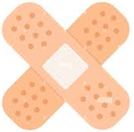
Official Terminologies
Quantum Broken
RSA
DSA
ECDSA
DHKE
El Gamal
Quantum Safe
AES-256
Twofish-256
SHA3/ BLAKE2
HMAC/ CMAK
bcrypt/ Scrypt
sPRP
Quantum Secure/ Resistant
qPRP
??
Public-Key schemes and Digital Signature Schemes
Symmetric ciphers, Hashes, MACs and KDFs
Notes:
Institute for quantum computing
Quantum Safe Cryptography

Slide 9
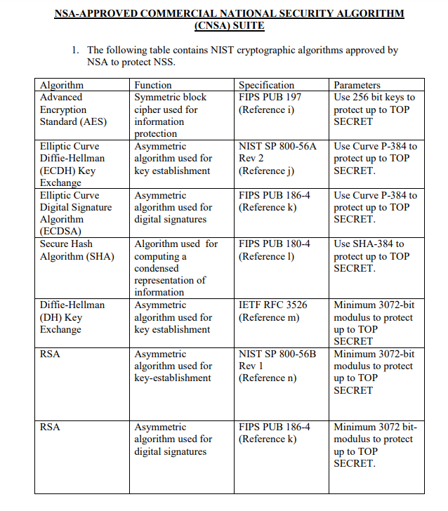
What was the response?
In July 2015 the NSA, recommended increasing the security level to be used in their Suite B set of cryptographic algorithms while transitioning to quantum-resistant alternatives.
Issues :
Larger Key sizes
Costlier operations
Only meant to tend to critical information

Slide 10
What was the response?
The NSA stressed on the need to develop standards for post-quantum cryptography (PQC).
“the time is right to make a major push to design public-key cryptographic protocols whose security depends on hard problems that cannot be solved efficiently by a quantum computer.”
Called for efforts to develop, standardize, and commercialize “quantum-safe” cryptography.
In the immediate future the NSA is encouraging vendors to add quantum-resistance to existing protocols by means of conventional symmetric-key tools such as AES.
Secure Communication cannot be done just by using symmetric encryption schemes and hashes. We need to address post-quantum public-key schemes.
Notes:
Lattice based crypto

Slide 11
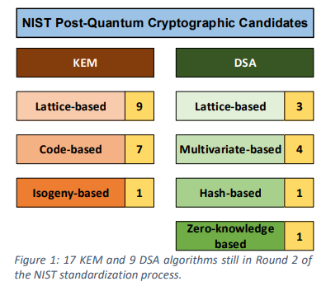
What was the response?
NIST Post-Quantum Cryptography Standardization - a competition followed by a workshop in 2016, to standardize quantum safe KEM and DSA algorithms, which would replace ECC and RSA.
Was expected to announce the algorithms to be standardized in Jan 2022.
Issues:
Suboptimal evaluation metrics
Would require a complete overhaul of internet security
Costly operations - Will the average desktop be able to handle?
Notes:
currently in the middle of a multiyear standardization process
Latency

Slide 12
What was the response?
ETSI, partnered with IQC, has been focused on the practical implementation of quantum-safe primitives since 2015 and has published an ETSI Guide and held yearly workshops,
IETF (focused on promoting voluntary internet standards) is currently developing RFC protocols compatible with post-quantum cryptography.
ANSI made some recommendations on lattice-based algorithms.
The research community has already developed some definitions, and are working to ease the transition from theory to practice by keeping the internet community aware of what is going on.
Notes:
Internet Engineering Task Force
American National Standards Institute

Slide 13

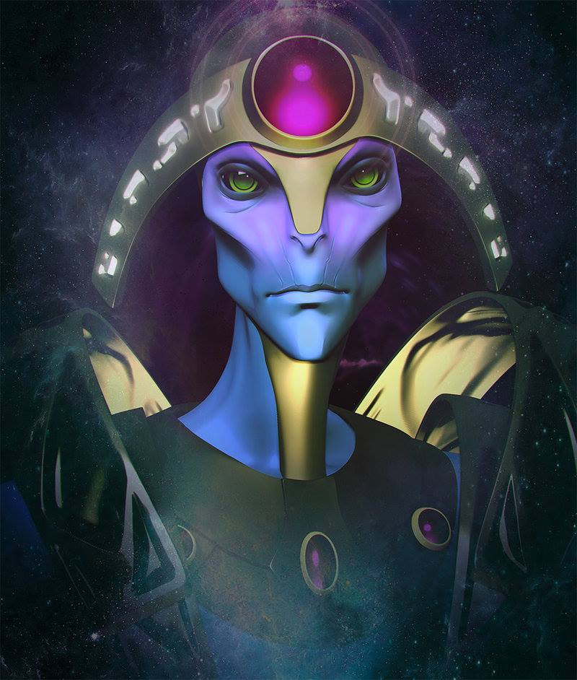
What does a security definition look like?
A security scheme is evaluated for its correctness, privacy/ indistinguishability, integrity.
The IND-CPA Game : Indistinguishability against Chosen Plaintext Attacks
IND-CPA oracle with input m₀, m₁:
Choose b from {0,1}
Return ct ← E_{sk}(m_{b})
Learning Queries
Adversary
Chooses plaintexts m₀, m₁ for every query
Wins if it guesses b correctly
Challenge Queries; response depends on b
Learning Queries
Notes:
Oracle simulates the encryption scheme, interaction with adversary

Slide 14

Connecting the Dots
Also need a suitable definition
Play with this ?
Parameters:
- Query Type
- Computational Resources
Parameters:
- Model of Scheme
- Output of Challenge Queries
Quantum Broken Schemes
Safe only against adversaries with:
Classical Resources
Classical Queries
Quantum Safe Schemes
Safe against adversaries with:
Quantum Resources
Classical Queries
Quantum Secure Schemes
Safe against adversaries with:
Quantum Resources
Quantum Queries

Slide 15
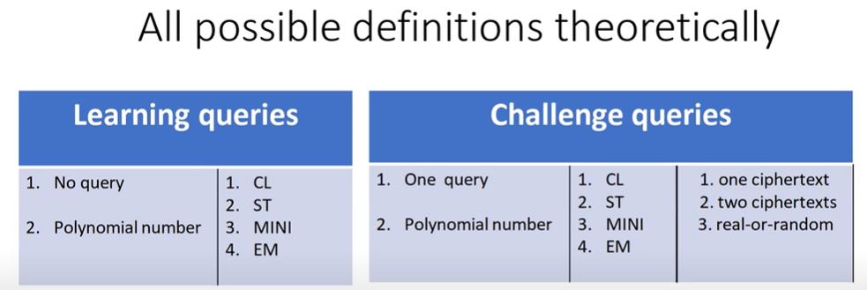

Is it possible to do it classically?
Boneh-Zhandry : Standard Query Model (ST) ⇒ |x, y〉 → |x, y ⊕ Enc_{sk}(x;r)〉
Gagliardoni et. al. : Minimal Query Model (MI) ⇒ |x〉→ |Enc_{sk}(x;r)〉
Carstens et. al. : Embedding Query Model (EM) ⇒ |x, 0〉 → |x, Enc_{sk}(x;r)〉
Classical Query Model (CL) ⇒ x → Enc_{sk}(x;r)

Slide 16
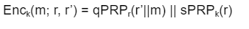
Documenting the challenges
l(0,-)c(*,ST,ror) [BZ] and l(0,-)c(*,MINI,1ct) [G] strongest definitions, satisfied by
The use of qPRP
Exponential length keys
Exponential number of block cipher operations
Not practical
Use a weaker definition?
Weaker security guarantees
Definitions may not model actual schemes
Notes:
We are up against quantum adversaries, we need quantum allies

Slide 17
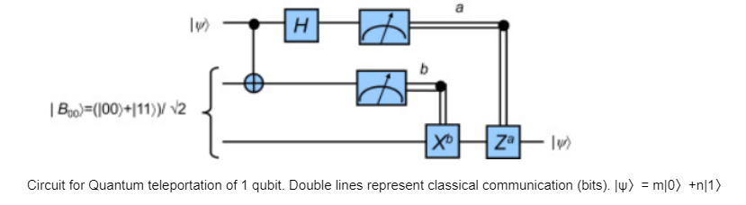


Quantum Key Distribution (QKD)
Uses Quantum Teleportation
Alice has the key R, creates corresponding quantum state |R〉, creates bits a,b which can only be reversed by Bob to get back |R〉
Because Bob holds the entangled partner qubits.
Notes:
We are up against quantum adversaries, we need quantum allies

Slide 18
Securing the classical communication
One Time Pad (OTP) : C ← M ⊕ K
Perfectly secure
Quantum secure
Why haven’t we used OTP already ?
Keys cannot be repeated! C₁ ← M₁ ⊕ K; C₂ ← M₂ ⊕ K M₁ ← C₁ ⊕ C₂ ⊕ M₂
Need to send new keys for every message
Encrypt the keys (KEM). What scheme? Nothing practical is quantum secure. A quantum attacker can extract the key during the exchange.
Quantum Teleportation bridges this gap.
Provides security and repeatability
Cannot extract key from bits (a, b) without access to the entangled qubits.
Notes:
We are up against quantum adversaries, we need quantum allies

Slide 19
Proving security : Correctness
QKD : Depends on error correction and fault tolerance of QT implementations
OTP : Can we produce a ciphertext C (given a key K) that decrypts to 2 different messages M ?
C ← M ⊕ K ⇒ M ← C ⊕ K ∀M∈MsgSp ∀K∈KeySp
There is only one possible M given a C and K. Correctness of QKD+OTP depends if the key is transferred correctly.
Notes:
We are up against quantum adversaries, we need quantum allies

Slide 20
Proving security : Confidentiality
qIND$-EAV definition : Indistinguishability against quantum eavesdropper
Adversary can issue quantum queries (multiple inputs at the same time), and has quantum resources (to comb through the results)
qIND$-EAV oracle:
Creates |r₁〉 + |r₂〉 + |r₃〉 + … + |r_{k}〉
Creates |r’₁〉 + |r’₂〉 + |r’₃〉 + … + |r’₃〉
Chooses b from {0,1}
If b = 0
Returns ct ← |m₁⊕r₁〉 + |m₂⊕r₂〉 + |m₃⊕r₃〉 + … + |m_{k}⊕r_{k}〉
Else
Returns ct ← |r’₁〉 + |r’₂〉 + |r’₃〉 + … + |r’_{k}〉
|m₁〉 + |m₂〉 + |m₃〉 + … + |m_{k}〉
Adversary
Sends superposition of messages of its choice
Wins if it guesses b correctly
Learning Queries
Challenge Queries; response depends on b
Learning Queries
Notes:
We are up against quantum adversaries, we need quantum allies

Slide 21
Proving security : Confidentiality
Adversary’s strategy : Guess |r₁〉 + |r₂〉 + |r₃〉 + … + |r_{k}〉 ! Xor with C. If it matches |m₁〉 + |m₂〉 + |m₃〉 + …, output 0.
Every r_{i} is picked from n-bit space. MsgSp is also n bit.
∀m_{i} ∈ MsgSp Pr[E(R, m_{i}) = c_{i}] ⇒ Pr[R ⊕ m_{i} = c_{i}] ⇒ Pr[R = m_{i} ⊕ c_{i}] = (½)^n
If b = 0, adversary outputs 0 with probability (½)^n.
But, if b = 1, adversary also outputs 0 with probability (½)^n.
Adversary cannot distinguish, has 0 advantage.
OTP is perfectly secure.
Notes:
We are up against quantum adversaries, we need quantum allies

Slide 22
Proving security : Integrity
Ciphertext has C, a, b.
Need to ensure that if anything is changed, Bob is alerted of the presence of the eavesdropper and does not accept the tampered ciphertext.
Turns out the quantum safe MACs like HMAC-SHA-3 are suitable for this. MAC will create a checksum value.
Need a pre-established MAC key K_{M}, between both parties.
Notes:
We are up against quantum adversaries, we need quantum allies

Slide 23
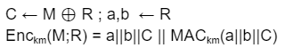
Final QKD + OTP looks like
Alice chooses random key R.
Creates classical bits a, b to teleport R to Bob.
Creates ciphertext C
MACs all the classical values using the key K_{M}.
Bob receives a’||b’||C’||checksum
If MAC_{Km}(a’||b’||C’) ≠ checksum, drop ciphertexts.
Else, recreate R from a, b.
Decrypt message M ← C ⊕ R
Notes:
We are up against quantum adversaries, we need quantum allies

Slide 24
Results and Conclusions
A new quantum secure encryption scheme : QKD + OTP
A new security definition to model this : qIND$-EAV
Needs a quantum channel-a means for sending quantum bits between locations.
Such channels have been built for over short distances. A team of researchers from Fermilab, AT&T, Caltech, Harvard University, NASA Jet Propulsion Laboratory, and University of Calgary teleported qubits between 2 systems, over 27 miles.
In the long-term, satellite quantum communication and quantum repeaters will enable global QKD.
Scientists in China claim they are close.
Quantum secure ⇒ No computational assumptions
Notes:
We are up against quantum adversaries, we need quantum allies

Slide 25
Some of the many hurdles
Could not test this out because a 2000 qubit quantum computer was available at only $15 million.
Road to a fully-fledged, working quantum computer is full of challenges.
Scalability, fault tolerance, error correction, efficiency
Need a lot of perfect logical qubits. IARPA trying to build “a logical qubit from a number of imperfect physical qubits”
Switching to new algorithms will be inconvenient at best and disruptive at worst.
The question of when to incur this cost depends on how fast the technology is built.
We are good for a few years. To crack the encryption methods that are currently serving us, these computers will have to come a long way. But quantum computing is growing faster than classical computing ever did.
Notes:
We are up against quantum adversaries, we need quantum allies

Slide 26
Future Work
Researching whether QT can be used to form a quantum-secure DSA. Classical proofs of quantum knowledge?
Theorizing classical schemes which can provide guarantees and be practical
Can the weaker definitions lead to something
Working with the QT circuit, possibly exploiting more quantum phenomena
In 15 years, practical deployments of both quantum and post-quantum cryptography will enable the applied cryptography and security community to battle-test these solutions under real-world conditions and better prepare them for “showtime” when the current cryptography tools are no longer able to provide the required security.
Business and policy decisions that would drive the adoption of quantum-safe cryptography.
Notes:
We are up against quantum adversaries, we need quantum allies

Slide 27
References
https://www.thesslstore.com/blog/quantum-computings-threat-public-key-cryptography-need-worry/
https://scrambox.com/article/brute-force-aes/
https://www.quintessencelabs.com/blog/breaking-rsa-encryption-update-state-art/
http://xeushack.com/how-quantum-computing-will-turn-digital-security-upside-down
https://imlive.s3.amazonaws.com/Federal%20Government/ID151830346965529215587195222610265670631/CNSSP15.pdf
https://ieeexplore.ieee.org/document/8490169
https://eprint.iacr.org/2021/1637.pdf
https://www.pqsecurity.com/wp-content/uploads/2020/02/PQ-Standardization-Discussion.pdf
https://www.datacenterknowledge.com/networks/quantum-teleportation-makes-progress-toward-what
Notes:
If all evaluated circuits output the same bit, then this bit is the correct output with probability 1-2^-t (since in order to cheat, the sender must guess all the checked circuits and all the evaluated ones). However, if some of the evaluated circuits output different bits, then the receiver knows that the sender is trying to cheat and needs to determine the right output.

Slide 28
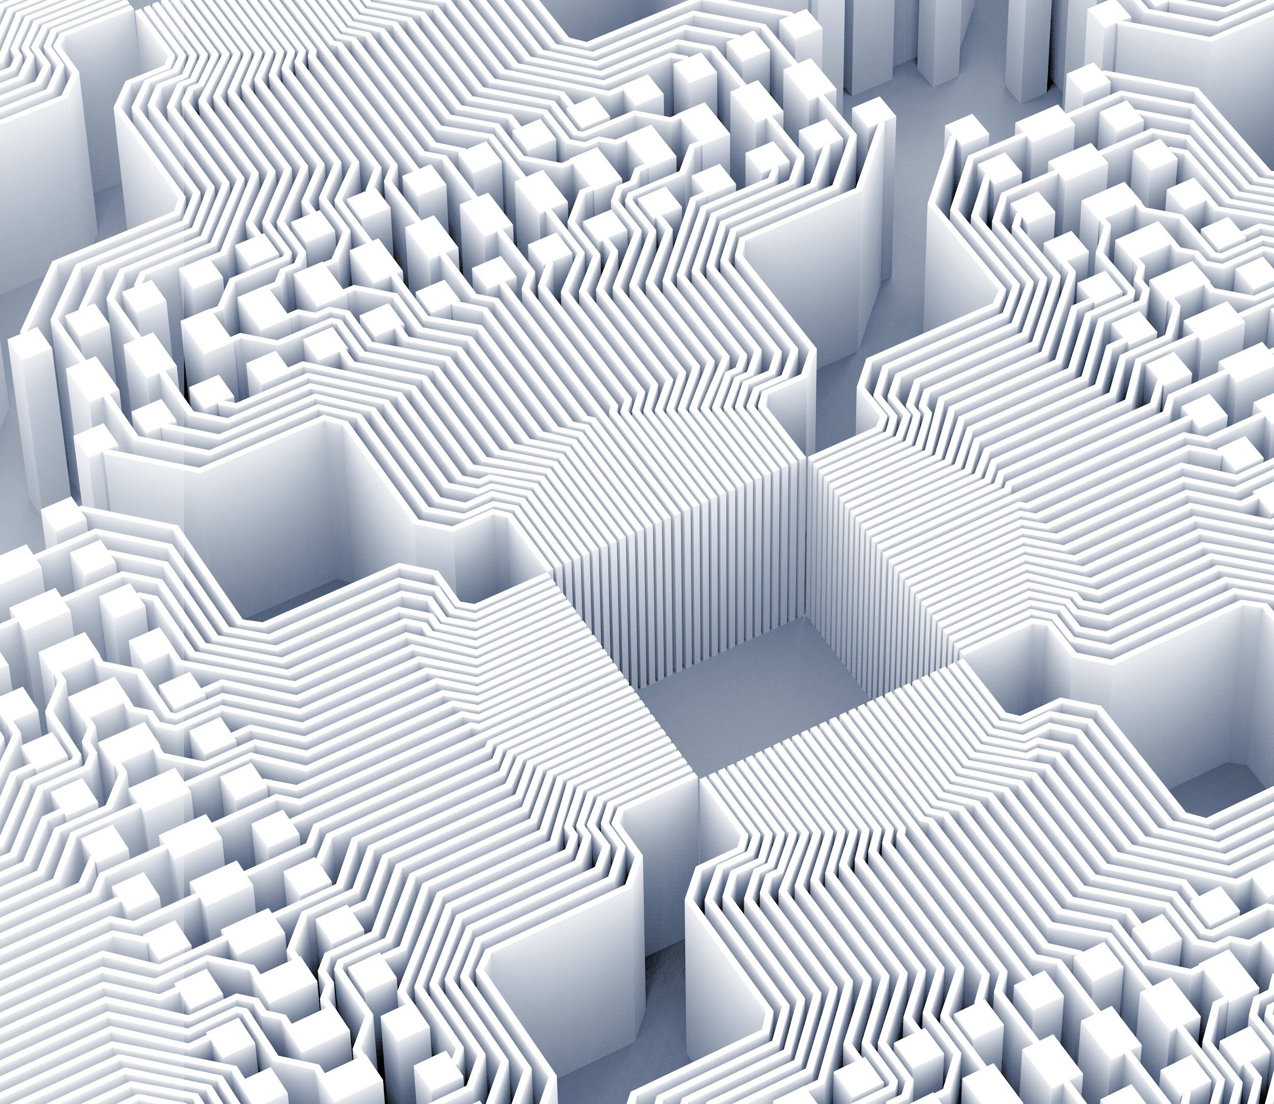


Thank you for listening!
QKD + OTP

